Slide 1
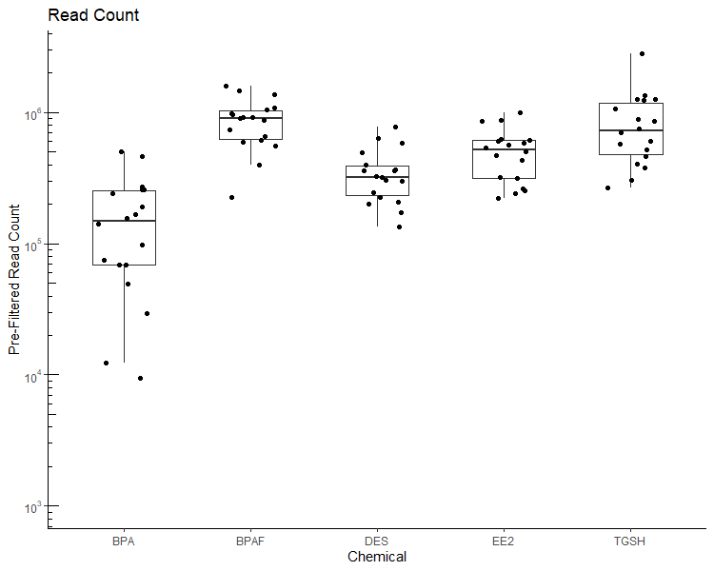
Read Count
Chemical | Mean Read Count | StDev
BPA | 170 532 | 144 138
BPAF | 885 426 | 358 508
DES | 356 467 | 170 704
EE2 | 515 393 | 229 213
TGSH | 873 903 | 601 039

Slide 2
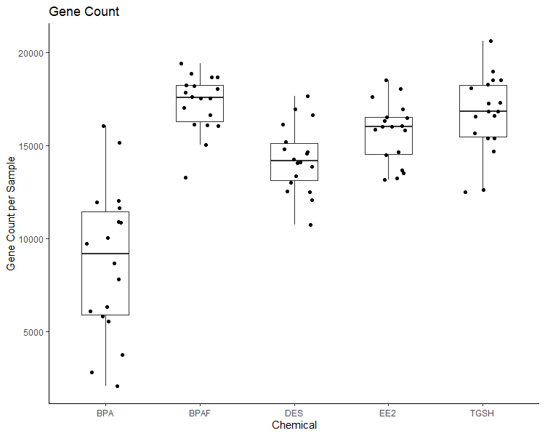
Gene Count
Chemical | Mean Gene Count | StDev
BPA | 8 730 | 4 010
BPAF | 17 277 | 1 525
DES | 14 287 | 1 805
EE2 | 15 723 | 1 622
TGSH | 16 711 | 2 106

Slide 3
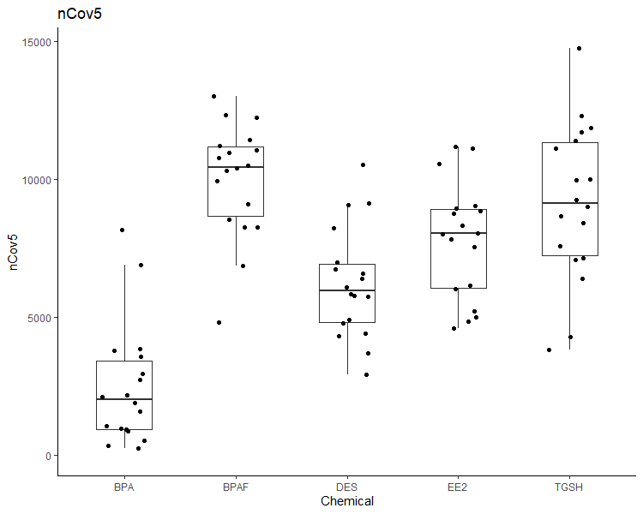
nCov5
Chemical | Mean nCov5 | StDev
BPA | 2 488 | 2 180
BPAF | 10 004 | 2 056
DES | 6 238 | 2 010
EE2 | 7 784 | 2 098
TGSH | 9 158 | 2 836

Slide 4
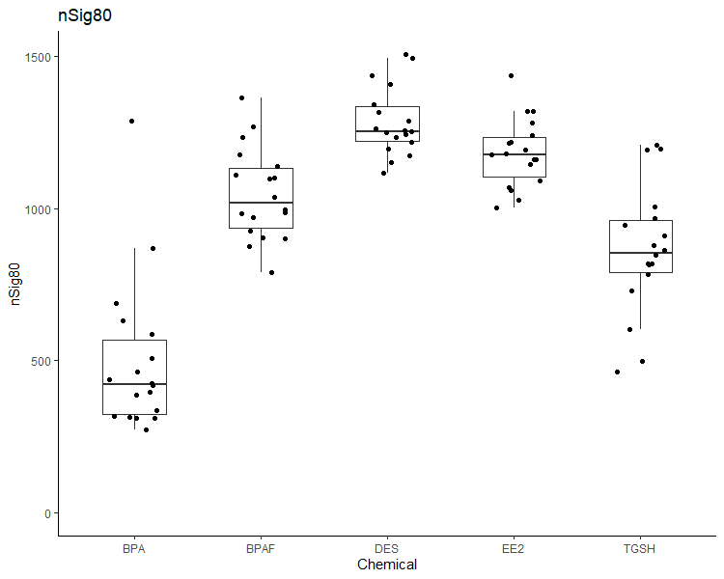
nSig80
Chemical | Mean nSig80 | StDev
BPA | 498 | 251
BPAF | 1 048 | 151
DES | 1 286 | 112
EE2 | 1 183 | 111
TGSH | 864 | 213

Slide 5
Chemical | Sample | Dose | Read Count | Gene Count | nCovN | nSig80 | Chemical | Sample | Dose | Read Count | Gene Count | nCovN | nSig80 | Chemical | Sample | Dose | Read Count | Gene Count | nCovN | nSig80
BPA | BPA_0ugL_A.csv | 0 | 68,307 | 6,308 | 924 | 310 | DES | DES_0ugL_A.csv | 0 | 172,986 | 12,052 | 3,716 | 1,217 | TGSH | TGSH_0ugL_A.csv | 0 | 267,362 | 12,512 | 3,830 | 462
BPA | BPA_0ugL_B.csv | 0 | 12,280 | 2,797 | 358 | 689 | DES | DES_0ugL_B.csv | 0 | 492,791 | 16,136 | 8,248 | 1,437 | TGSH | TGSH_0ugL_B.csv | 0 | 889,649 | 17,279 | 9,971 | 819
BPA | BPA_0ugL_C.csv | 0 | 165,874 | 8,657 | 1,904 | 274 | DES | DES_0ugL_C.csv | 0 | 245,397 | 13,022 | 4,786 | 1,116 | TGSH | TGSH_0ugL_C.csv | 0 | 305,223 | 12,606 | 4,298 | 497
BPA | BPA_0.1ugL_A.csv | 0.1 | 49,668 | 5,551 | 880 | 462 | DES | DES_0.01ugL_A.csv | 0.01 | 367,623 | 14,653 | 6,589 | 1,245 | TGSH | TGSH_0.1ugL_A.csv | 0.1 | 2,820,990 | 20,638 | 14,757 | 819
BPA | BPA_0.1ugL_B.csv | 0.1 | 191,805 | 10,877 | 2,745 | 427 | DES | DES_0.01ugL_B.csv | 0.01 | 227,186 | 13,366 | 4,922 | 1,409 | TGSH | TGSH_0.1ugL_B.csv | 0.1 | 702,731 | 16,561 | 8,680 | 731
BPA | BPA_0.1ugL_C.csv | 0.1 | 155,687 | 10,039 | 2,164 | 386 | DES | DES_0.01ugL_C.csv | 0.01 | 776,675 | 17,648 | 10,543 | 1,507 | TGSH | TGSH_0.1ugL_C.csv | 0.1 | 852,830 | 17,298 | 9,997 | 862
BPA | BPA_1ugL_A.csv | 1 | 29,517 | 3,721 | 535 | 338 | DES | DES_0.1ugL_A.csv | 0.1 | 589,028 | 16,647 | 9,133 | 1,495 | TGSH | TGSH_1ugL_A.csv | 1 | 1,233,119 | 18,504 | 11,710 | 880
BPA | BPA_1ugL_B.csv | 1 | 141,428 | 9,728 | 2,125 | 439 | DES | DES_0.1ugL_B.csv | 0.1 | 635,451 | 16,942 | 9,070 | 1,197 | TGSH | TGSH_1ugL_B.csv | 1 | 1,068,203 | 18,108 | 11,132 | 944
BPA | BPA_1ugL_C.csv | 1 | 68,355 | 5,829 | 984 | 313 | DES | DES_0.1ugL_C.csv | 0.1 | 396,997 | 15,214 | 7,002 | 1,262 | TGSH | TGSH_1ugL_C.csv | 1 | 1,260,507 | 18,303 | 11,393 | 784
BPA | BPA_10ugL_A.csv | 10 | 9,420 | 2,049 | 244 | 396 | DES | DES_1ugL_A.csv | 1 | 133,376 | 10,722 | 2,939 | 1,174 | TGSH | TGSH_10ugL_A.csv | 10 | 1,358,537 | 18,993 | 12,312 | 1,007
BPA | BPA_10ugL_B.csv | 10 | 506,577 | 16,043 | 8,171 | 1,287 | DES | DES_1ugL_B.csv | 1 | 359,669 | 14,573 | 6,403 | 1,256 | TGSH | TGSH_10ugL_B.csv | 10 | 579,312 | 15,677 | 7,586 | 602
BPA | BPA_10ugL_C.csv | 10 | 75,011 | 6,098 | 1,067 | 318 | DES | DES_1ugL_C.csv | 1 | 323,592 | 14,275 | 6,092 | 1,251 | TGSH | TGSH_10ugL_C.csv | 10 | 746,491 | 16,842 | 9,247 | 814
BPA | BPA_100ugL_A.csv | 100 | 242,788 | 11,932 | 3,800 | 632 | DES | DES_10ugL_A.csv | 10 | 209,256 | 12,496 | 4,410 | 1,287 | TGSH | TGSH_100ugL_A.csv | 100 | 380,016 | 14,686 | 6,394 | 969
BPA | BPA_100ugL_B.csv | 100 | 97,241 | 7,821 | 1,595 | 507 | DES | DES_10ugL_B.csv | 10 | 200,899 | 12,526 | 4,324 | 1,317 | TGSH | TGSH_100ugL_B.csv | 100 | 606,394 | 16,846 | 9,015 | 1,195
BPA | BPA_100ugL_C.csv | 100 | 272,918 | 11,649 | 3,590 | 418 | DES | DES_10ugL_C.csv | 10 | 302,160 | 13,881 | 5,756 | 1,253 | TGSH | TGSH_100ugL_C.csv | 100 | 1,263,190 | 18,531 | 11,879 | 912
BPA | BPA_1000ugL_A.csv | 1000 | 258,801 | 12,013 | 3,865 | 588 | DES | DES_100ugL_A.csv | 100 | 318,271 | 14,074 | 5,833 | 1,151 | TGSH | TGSH_1000ugL_A.csv | 1000 | 407,701 | 15,398 | 7,085 | 1,193
BPA | BPA_1000ugL_B.csv | 1000 | 464,577 | 15,162 | 6,884 | 868 | DES | DES_100ugL_B.csv | 100 | 304,872 | 14,113 | 5,795 | 1,235 | TGSH | TGSH_1000ugL_B.csv | 1000 | 522,452 | 16,609 | 8,426 | 1,210
BPA | BPA_1000ugL_C.csv | 1000 | 259,319 | 10,871 | 2,945 | 312 | DES | DES_100ugL_C.csv | 100 | 360,177 | 14,821 | 6,731 | 1,341 | TGSH | TGSH_1000ugL_C.csv | 1000 | 465,548 | 15,411 | 7,141 | 848
BPAF | BPAF_0ugL_A.csv | 0 | 558,233 | 16,042 | 8,277 | 987 | EE2 | EE2_0ugL_A.csv | 0 | 990,688 | 18,041 | 11,124 | 1,146
BPAF | BPAF_0ugL_B.csv | 0 | 925,975 | 17,526 | 10,409 | 903 | EE2 | EE2_0ugL_B.csv | 0 | 562,983 | 16,029 | 8,337 | 1,028
BPAF | BPAF_0ugL_C.csv | 0 | 975,829 | 17,873 | 10,778 | 985 | EE2 | EE2_0ugL_C.csv | 0 | 602,674 | 16,343 | 8,758 | 1,068
BPAF | BPAF_0.1ugL_A.csv | 0.1 | 904,542 | 17,604 | 10,309 | 926 | EE2 | EE2_0.0001ugL_A.csv | 0.0001 | 630,648 | 16,534 | 8,949 | 1,059
BPAF | BPAF_0.1ugL_B.csv | 0.1 | 616,936 | 16,112 | 8,250 | 790 | EE2 | EE2_0.0001ugL_B.csv | 0.0001 | 864,309 | 17,611 | 10,555 | 1,177
BPAF | BPAF_0.1ugL_C.csv | 0.1 | 1,479,243 | 18,867 | 12,325 | 875 | EE2 | EE2_0.0001ugL_C.csv | 0.0001 | 321,745 | 14,484 | 6,041 | 1,218
BPAF | BPAF_1ugL_A.csv | 1 | 1,599,084 | 19,416 | 13,029 | 1,111 | EE2 | EE2_0.001ugL_A.csv | 0.001 | 469,201 | 16,006 | 7,825 | 1,179
BPAF | BPAF_1ugL_B.csv | 1 | 1,372,600 | 18,675 | 12,237 | 996 | EE2 | EE2_0.001ugL_B.csv | 0.001 | 222,148 | 13,155 | 4,593 | 1,215
BPAF | BPAF_1ugL_C.csv | 1 | 745,220 | 17,026 | 9,952 | 1,176 | EE2 | EE2_0.001ugL_C.csv | 0.001 | 617,202 | 16,497 | 8,852 | 1,092
BPAF | BPAF_10ugL_A.csv | 10 | 400,331 | 15,037 | 6,859 | 1,099 | EE2 | EE2_0.01ugL_A.csv | 0.01 | 870,717 | 18,540 | 11,180 | 1,436
BPAF | BPAF_10ugL_B.csv | 10 | 661,714 | 16,643 | 9,110 | 1,038 | EE2 | EE2_0.01ugL_B.csv | 0.01 | 431,770 | 16,044 | 7,562 | 1,281
BPAF | BPAF_10ugL_C.csv | 10 | 1,078,296 | 18,036 | 11,062 | 902 | EE2 | EE2_0.01ugL_C.csv | 0.01 | 580,193 | 16,949 | 9,056 | 1,318
BPAF | BPAF_100ugL_A.csv | 100 | 225,053 | 13,289 | 4,826 | 1,363 | EE2 | EE2_0.1ugL_A.csv | 0.1 | 263,868 | 13,687 | 5,219 | 1,240
BPAF | BPAF_100ugL_B.csv | 100 | 912,465 | 18,206 | 10,978 | 1,270 | EE2 | EE2_0.1ugL_B.csv | 0.1 | 536,954 | 15,864 | 8,025 | 1,004
BPAF | BPAF_100ugL_C.csv | 100 | 869,295 | 17,544 | 10,496 | 1,100 | EE2 | EE2_0.1ugL_C.csv | 0.1 | 240,272 | 13,241 | 4,843 | 1,194
BPAF | BPAF_1000ugL_A.csv | 1000 | 1,056,427 | 18,674 | 11,427 | 1,140 | EE2 | EE2_1ugL_A.csv | 1 | 504,330 | 15,811 | 8,046 | 1,161
BPAF | BPAF_1000ugL_B.csv | 1000 | 598,141 | 16,151 | 8,538 | 972 | EE2 | EE2_1ugL_B.csv | 1 | 252,178 | 13,517 | 5,004 | 1,162
BPAF | BPAF_1000ugL_C.csv | 1000 | 958,279 | 18,267 | 11,208 | 1,235 | EE2 | EE2_1ugL_C.csv | 1 | 315,200 | 14,669 | 6,140 | 1,318

